Slide 1
CORE JAVA

Slide 2
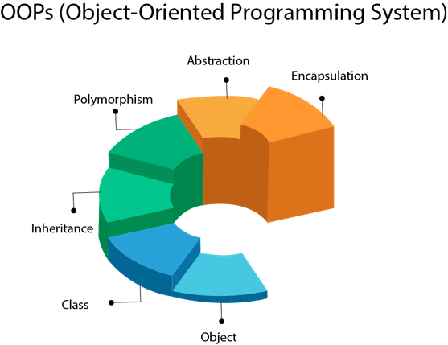
OBJECT –ORIENTED PROGRAMMING
Objects and classes
Data abstraction and Encapsulation
Inheritance
Polymorphism
Compile time and runtime Mechanism
Dynamic Binding
Message Communication

Slide 3
What is a class
Collection of objects is called class. It is a logical entity.
A class can also be defined as a blueprint from which you can create an individual object. Class doesn't consume any space.
Syntax:
class <classname>
{
fields declaration;
methods declaration;
}
Room? object
Objects?

Slide 4
Data abstraction and Encapsulation
Abstraction is the concept of object-oriented programming that "shows" only essential attributes and "hides" unnecessary information. The main purpose of abstraction is hiding the unnecessary details from the users. Abstraction is selecting data from a larger pool to show only relevant details of the object to the user. It helps in reducing programming complexity and efforts. It is one of the most important concepts of OOPs.
Encapsulation is one of the fundamental concepts in object-oriented programming (OOP). It describes the idea of bundling data and methods that work on that data within one unit, e.g., a class in Java.
This concept is also often used to hide the internal representation, or state, of an object from the outside. This is called information hiding. The general idea of this mechanism is simple. If you have an attribute that is not visible from the outside of an object, and bundle it with methods that provide read or write access to it, then you can hide specific information and control access to the internal state of the object.

Slide 5
Inheritance
Inheritance in java is a mechanism in which one object inherits all the properties and behaviors of parent object.
We use inheritance for :
For Method Overriding (so runtime polymorphism can be achieved).
For Code Reusability.
--When one object acquires all the properties and behaviors of a parent object, it is known as inheritance. It provides code reusability. It is used to achieve runtime polymorphism.

Slide 6

Polymorphism
Polymorphism is the ability of an object to take on many forms. The most common use of polymorphism in OOP occurs when a parent class reference is used to refer to a child class object.
Types of polymorphism
Compile-time polymorphism // method overloading
Run-time polymorphism // method overriding

Slide 7
First code in JAVA
To create a simple java program, you need to create a class that contains the main method.
Let's understand the requirement first.
For executing any java program, you need to
Install the JDK if you don't have installed it, download the JDK and install it.
Set path of the jdk/bin directory.
Create the java program
Compile and run the java program
class Simple{
public static void main(String args[]){
System.out.println("Hello Java");
}
}

Slide 8
Breaking Down the code
class keyword is used to declare a class in java.
public keyword is an access modifier which represents visibility. It means it is visible to all.
static is a keyword. If we declare any method as static, it is known as the static method. The core advantage of the static method is that there is no need to create an object to invoke the static method. The main method is executed by the JVM, so it doesn't require to create an object to invoke the main method. So it saves memory.
void is the return type of the method. It means it doesn't return any value.
main represents the starting point of the program.
String[] args is used for command line argument. We will learn it later.
System.out.println() is used to print statement. Here, System is a class, out is the object of PrintStream class, println() is the method of PrintStream class.

Slide 9
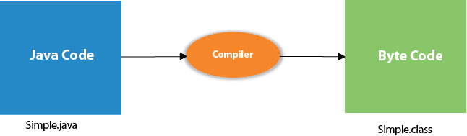
Simple JAVA Program
save this file as Simple.java
To compile: | javac Simple.java
To execute: | java Simple
Compilation Flow:
When we compile Java program using javac tool, java compiler converts the source code into byte code.

Slide 10
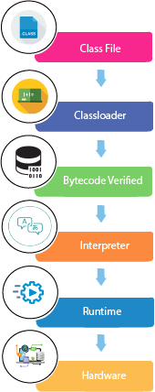
What happens at run time

Slide 11
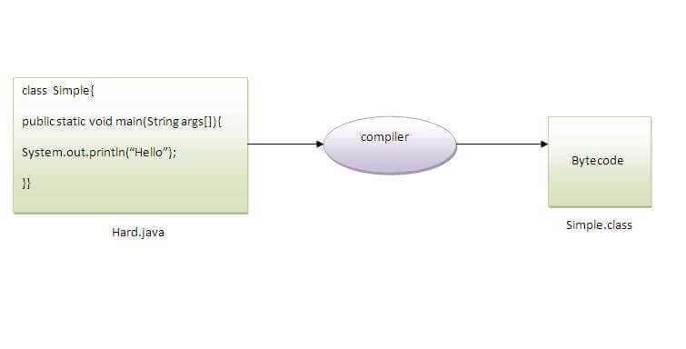
Save a java source file by other name
Yes, if the class is not public. It is explained in the figure given below:
To compile: | javac Hard.java
To execute: | java Simple

Slide 12
Memory management in java
Heap: It is created by the Java Virtual Machine when it starts. The memory is used as long as the application is running. Java runtime uses it to allocate memory to objects and Java Runtime Environment (JRE) classes.
Young generation
Old generation
Garbage collection
Stack: This is the temporary memory where variable values are stored when their methods are invoked. After the method is finished, the memory containing those values is cleared to make room for new methods.
When a new method is invoked, a new block of memory will be created in the Stack. This new block will store the temporary values invoked by the method and references to objects stored in the Heap that are being used by the method.

Slide 13
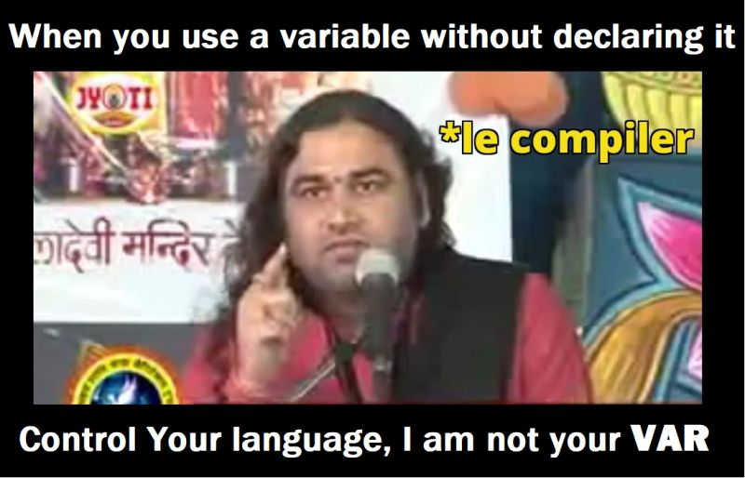
Core concepts: Variables and identifiers
A variable is a container which holds the value while the Java program is executed. A variable is assigned with a data type.
Variable is a name of memory location. There are three types of variables in java: local, instance and static.
Variable is name of reserved area allocated in
memory. In other words, it is a name of memory
location.
It is a combination of "vary + able" that means its
value can be changed.

Slide 14
Types of variables:
There are three types of variables in Java:
1) Local Variable
A variable declared inside the body of the method is called local variable. You can use this variable only within that method and the other methods in the class aren't even aware that the variable exists.
A local variable cannot be defined with "static" keyword.
2) Instance Variable
A variable declared inside the class but outside the body of the method, is called instance variable. It is not declared as static.
It is called instance variable because its value is instance specific and is not shared among instances.

Slide 15
Types of variables:
3) Static variable
A variable which is declared as static is called static variable. It cannot be local. You can create a single copy of static variable and share among all the instances of the class. Memory allocation for static variable happens only once when the class is loaded in the memory.
class A{
int data=50;//instance variable
static int m=100;//static variable Class Student
void method(){
int n=90;//local variable
}
}//end of class

Slide 16
Standard output
System.out: This is the standard output stream that is used to produce the result of a program on an output device like the computer screen.
Different functions with System.out
print()
println()
printf()

Slide 17
Standard input:
System.in: This is the standard input stream that is used to read characters from the keyboard or any other standard input device.
Scanner class: Scanner is a class in java.util package used for obtaining the input of the primitive types like int, double, etc. and strings. It is the easiest way to read input in a Java program.
Example:
Scanner sc = new Scanner(System.in);
int i = sc.nextInt();

Slide 18
Coding Exercise for the session
read an integer, a double, and a String from stdin, then print the values
Sample Input
42
3.1415
Welcome to Java tutorials!
Sample Output
String: Welcome to Java tutorials!
Double: 3.1415
Int: 42
Take two Strings as input from user and concatenate the two strings, and print it.
Sample input: hello
class
Sample output: hello class

Slide 19
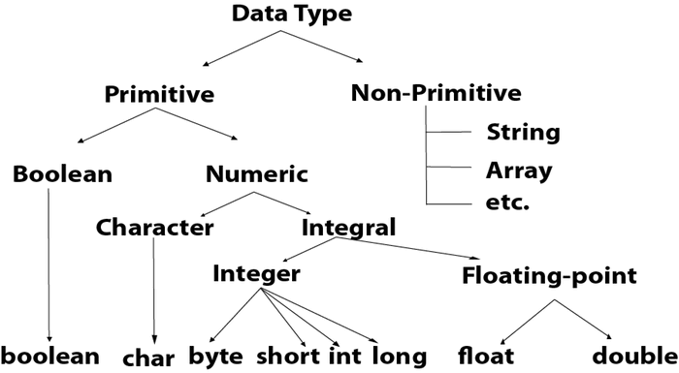
Data types in JAVA

Slide 20
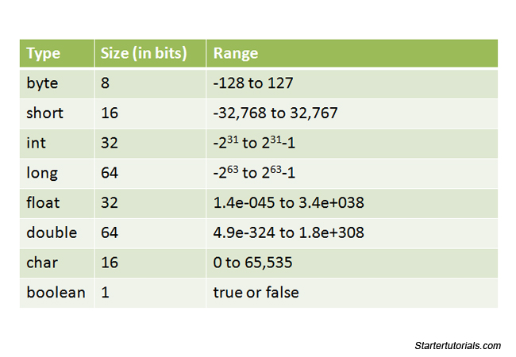
Data Types in Java

Slide 21
Type conversion (Widening)
Widening or type conversion means converting a smaller data type into a bigger size data type. i.e. Providing more space to a variable by converting it’s data type.
Example:
class Simple{
public static void main(String[] args){
int a=10; //Assigning value 10 to a variable “a” of int type
float f=a; // Assigning value of “a” to variable “f” which is of type float.
System.out.println(a);
System.out.println(f);
}}

Slide 22
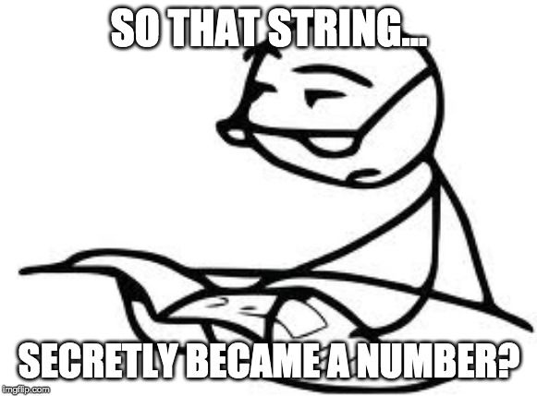
Type casting (Narrowing)
Type casting is a method in which you convert a bigger size data type into a smaller one.
Example:
class Simple{
public static void main(String[] args){
float f=10.5f;
//int a=f;//Compile time error // assigning float value to int value// larger value to smaller value
int a=(int)f;
System.out.println(f);
System.out.println(a);
}}

Slide 23
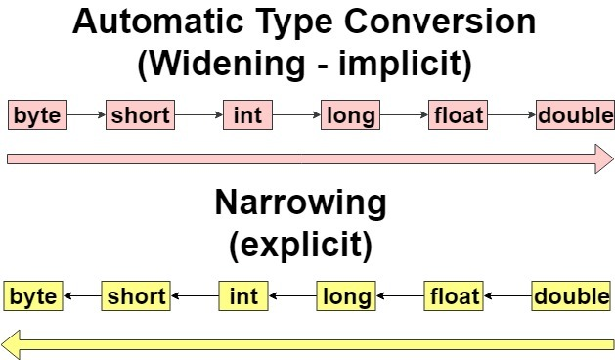
Type Promotion
Whenever evaluating a expression JAVA do some automating type conversions which is called type promotion.
Rule of automatic type conversion:
If evaluating expression with variables of type short or byte, result will automatically promoted to integer type.
If you are evaluating the expression having variables of multiple data type the result will always be stored in the variable with largest data type in expression.

Slide 24
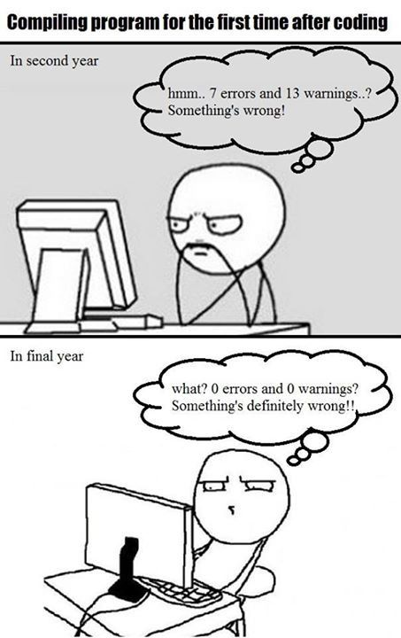
Coding exercise:
Write a Java program to convert temperature from Fahrenheit to Celsius degree.
Write a Java program to takes the user for a distance (in meters) and the time was taken (as three numbers: hours, minutes, seconds), and display the speed, in meters per second, kilometers per hour.

Slide 25
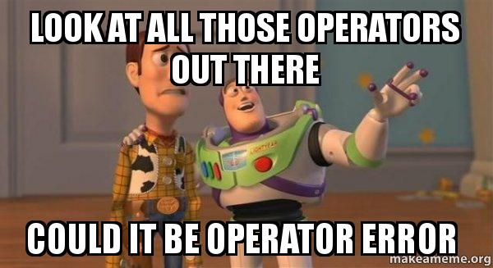
Operators in JAVA
Operators are symbols that perform operations on variables and values. For example, + is an operator used for addition, while * is also an operator used for multiplication.

Slide 26
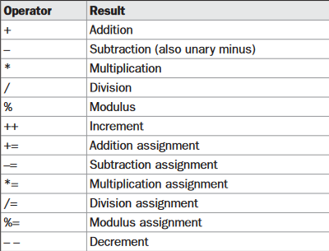
Arithmetic operators:

Slide 27
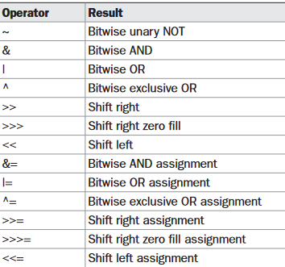
Bitwise Operators

Slide 28
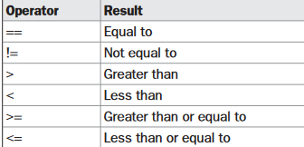
Relational operators

Slide 29
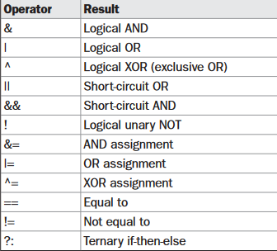
Boolean Logical operators

Slide 30
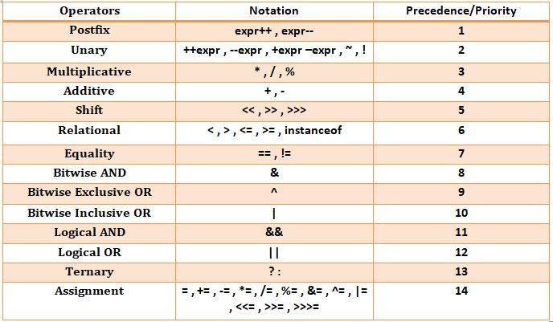
Precedence of operators java

Slide 31
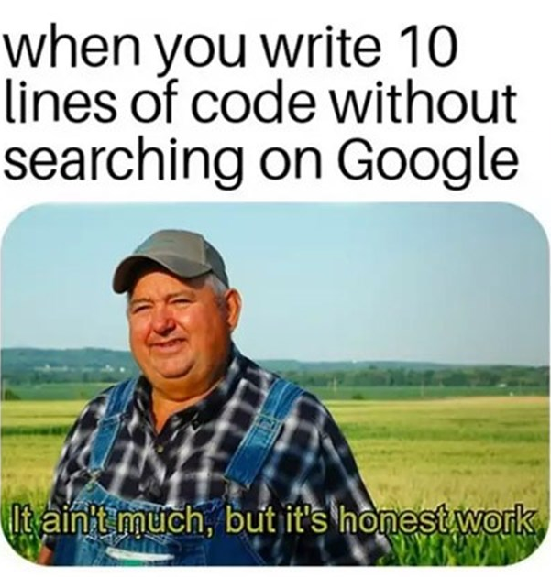
Practice questions:
The total number of students in a class are 90 out of which 45 are boys. If 50% of the total students secured grade 'A' out of which 20 are boys, then write a program to calculate the total number of girls getting grade 'A’.
Write a program to calculate the sum of the first and the second last digit of a 5 digit. E.g.- NUMBER : 12345 OUTPUT : 1+4=5
Write a program to reverse a 3-digit number without using an array. E.g.-Number : 132 Output : 231

Slide 32
Control Statements
programming language uses control statements to cause the flow of execution to advance and branch based on changes to the state of a program. Java’s program control statements can be put into the following categories: selection, iteration, and jump. Selection statements allow your program to choose different paths of execution based upon the outcome of an expression or the state of a variable. Iteration statements enable program execution to repeat one or more statements (that is, iteration statements form loops).
Types of control Statement :
1. Selection or Decision statements
2. Iterative Statements or looping statements.

Slide 33
Decision Constructs
If-else
Nested if else
If else ladder
Switch

Slide 34
Practice questions if else:
program that uses an if-else-if ladder to determine which season a particular month is in.
Check whether the number is even or odd.
Write a program to convert marks into grades
Where A grade>85; B grade>75; C grade> 65; D grade<65
Write a program to check whether the triangle is valid or not if angles are given
Take the amount from user and calculate the discount for user.
For the purchase below 25000 discount 5%
If the purchase is above 25000 discount is 20%
If the purchase is above 50000 discount is 40%

Slide 35
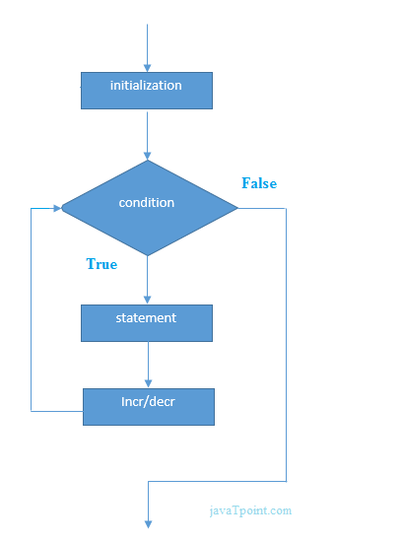
Looping statements
FOR LOOP: When the loop first starts, the initialization portion of the loop is executed. Generally, this is an expression that sets the value of the loop control variable, which acts as a counter that controls the loop. It is important to understand that the initialization expression is only executed once. Next, condition is evaluated. This must be a Boolean expression. It usually tests the loop control variable against a target value. If this expression is true, then the body of the loop is executed. If it is false, the loop terminates. Next, the iteration portion of the loop is executed.
for(initialization; condition; iteration) { // body }

Slide 36
For loop variants:
Boolean expression for loop
Example:
Boolean flag = ture;
for(int i=0; flag; i++)
No initialization and iteration
Example: for ( ; a>b ; )
Foreach loop
Example: for (int i: x)

Slide 37
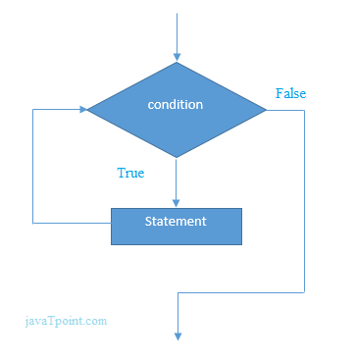
Looping statements
The while loop is Java’s most fundamental loop statement. It repeats a statement or block while its controlling expression is true. Here is its general form:
while(condition) { // body of loop }
The do-while loop always executes its body at least once, because its conditional expression is at the bottom of the loop. Its general form is do { // body of loop } while (condition);

Slide 38
Jump Statements:
Continue: Sometimes it is useful to force an early iteration of a loop. That is, you might want to continue running the loop but stop processing the remainder of the code in its body for this particular iteration. This is, in effect, a goto just past the body of the loop, to the loop’s end. The continue statement performs such an action.
Break: First, as you have seen, it terminates a statement sequence in a switch statement. Second, it can be used to exit a loop. Third, it can be used as a “civilized” form of goto.
Return: The last control statement is return. The return statement is used to explicitly return from a method. That is, it causes program control to transfer back to the caller of the method.

Slide 39
Coding Practice (loops):
Create a Restaurant customer service system where a waiter will keep on taking the order from customer until customer says done. Print the menu with at least 6 items customer will choose from that menu and in case of no order customer will give 0 as input. After the completion provide the customer with a bill also.
do it using for loop, while and do-while.

Slide 40


loop practice
Print the following pattern:
Find the sum and product of the n numbers. Take two inputs from user as N and Q if Q is equal to 1 than find the sum of the N natural numbers. If Q is equal to 2 than find the product of the first N natural numbers.

Slide 41
Arrays in JAVA
An array is a group of like-typed variables that are referred to by a common name. Arrays of any type can be created and may have one or more dimensions. A specific element in an array is accessed by its index. Arrays offer a convenient means of grouping related information.
Types of Array
Single dimensional array
Multi dimensional array
Jagged array

Slide 42
1-D Array
A one-dimensional array is, essentially, a list of like-typed variables. To create an array, you first must create an array variable of the desired type. The general form of a one-dimensional array declaration is:
type var-name[ ];
Array declaration types:
With new keyword
Example: int array[]= new int [4];
Without new keyword
Example int array[]= {1, 2, 3, 4};

Slide 43
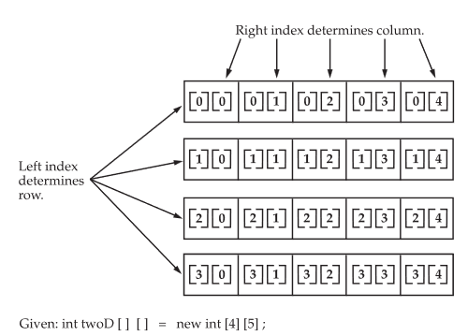
Multi dimensional Array
In Java, multidimensional arrays are actually arrays of arrays. These, as you might expect, look and act like regular multidimensional arrays. However, as you will see, there are a couple of subtle differences. To declare a multidimensional array variable, specify each additional index using another set of square brackets.
2D array: int arr [] []= new int[m][n];
3D array: int arr[][][]= new int [m][n][p];

Slide 44
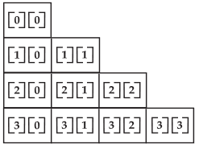
Jagged array
when you allocate dimensions manually, you do not need to allocate the same number of elements for each dimension. As stated earlier, since multidimensional arrays are actually arrays of arrays, the length of each array is under your control.
Example: int arr[][]= new int[4][];
arr[0]=new int [1];
arr[1]=new int [2];
arr[2]=new int [3];
arr[3]=new int [4];

Slide 45
Practice questions:
Write a program to create a 1D array of size 10 and add all the elements of the array.
Write a program to create a 2D array of m*n size print it in the form of matrix.
Write a program to create a jagged array to create a step shape 2d array.
Write a program to copy the elements of one array into another array.

Slide 46
Arrays Class
The Arrays class in java.util package is a part of the Java Collection Framework. This class provides static methods to dynamically create and access Java arrays. It consists of only static methods and the methods of Object class. The methods of this class can be used by the class name itself.

Slide 47
Why Array Class :/
the methods of this class help programmers expanding horizons with arrays for instance there are often times when loops are used to do some tasks on an array like:
Fill an array with a particular value.
Sort an Arrays.
Search in an Arrays.
And many more.

Slide 48
Methods of Arrays:
Arrays.toString()
Arrays.sort()
Arrays.binarySearch()
Arrays.compare()
Arrays.equal()

Slide 49
Practice Questions
Given an array of integers and an integer target. Write a program that return the indices of two numbers such that they add up to integer target.
Example: arr= [2, 7, 11, 15], target= 9;
output: [0,1] because 2+7=9
Given an integer array, rotate the array to right by k steps, where k is non negative number.
Example: arr=[1,2,3,4,5,6,7], k= 3
Output: [5,6,7,1,2,3,4]

Slide 50
Practice problems:
Given array of integers of size N-1 such that it only contains the integers in the range of 1 to N. find the missing element.
Example: N=5, arr={1,2,3,5}
Output: 4
Constraints: 1 ≤ N ≤ 10⁶ 1 ≤ A[i] ≤ 10⁶
https://practice.geeksforgeeks.org/problems/missing-number-in-array1416/1
Given a matrix M of r rows and c columns. Write a program to swap the first column with the last column.
https://practice.geeksforgeeks.org/problems/matrix-interchange-java/1

Slide 51
Classes and objects
Class: it defines a new data type. Once defined, this new type can be used to create objects of that type. Thus, a class is a template for an object, and an object is an instance of a class. Because an object is an instance of a class, you will often see the two words object and instance used interchangeably.
A class is declared by use of the class keyword.
The data, or variables, defined within a class are called instance variables. The code is contained within methods. Collectively, the methods and variables defined within a class are called members of the class.
Example: class G12{
String name;
Int roll_num;
void teacher(){}
void student(){}
}

Slide 52
Object
each time you create an instance of a class, you are creating an object that contains its own copy of each instance variable defined by the class.
you use the dot operator to access both the instance variables and the methods within an object.
Let’s see an example how to create an object of the class
when you create a class, you are creating a new data type. You can use this type to declare objects of that type. However, obtaining objects of a class is a two-step process. First, you must declare a variable of the class type. This variable does not define an object. Instead, it is simply a variable that can refer to an object. Second, you must acquire an actual, physical copy of the object and assign it to that variable. You can do this using the new operator. The new operator dynamically allocates (that is, allocates at run time) memory for an object and returns a reference to it. This reference is, more or less, the address in memory of the object allocated by new.

Slide 53
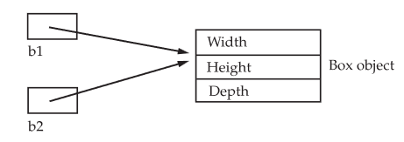
Memory allocation of objects and reference variables.
When you assign one object reference variable to another object reference variable, you are not creating a copy of the object, you are only making a copy of the reference.
Object reference variables act differently than you might expect when an assignment takes place.
Example: Box b1 = new Box(); Box b2 = b1;

Slide 54
Practice questions;
Create a class College with static data members name, location. Print the value of name and location.
What will be the output of the following code:
MyClass obj = new MyClass(2, 4, 6);
MyClass obj1 = obj;
MyClass obj2 = obj1;
obj2.setValue(8);
System.out.println(obj1.getValue());
What will be the output of the following code:
MyClass obj = new MyClass(1, 2, 3);
MyClass obj1 = obj;
MyClass obj2 = obj;
obj2 = new MyClass(4, 5, 6);
System.out.println(obj.getValue());

Slide 55
Methods
classes usually consist of two things: instance variables and methods.
A method in Java is a block of code that, when called, performs specific actions mentioned in it. For instance, if you have written instructions to draw a circle in the method, it will do that task.
This is the general form of a method: type name(parameter-list) { // body of method }

Slide 56
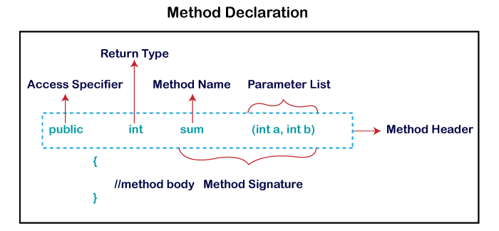
Methods

Slide 57
Types Methods
Parametrized
Non- parametrized
User-defined methods
Pre-defined methods
Instance methods
Static methods
Abstract method

Slide 58
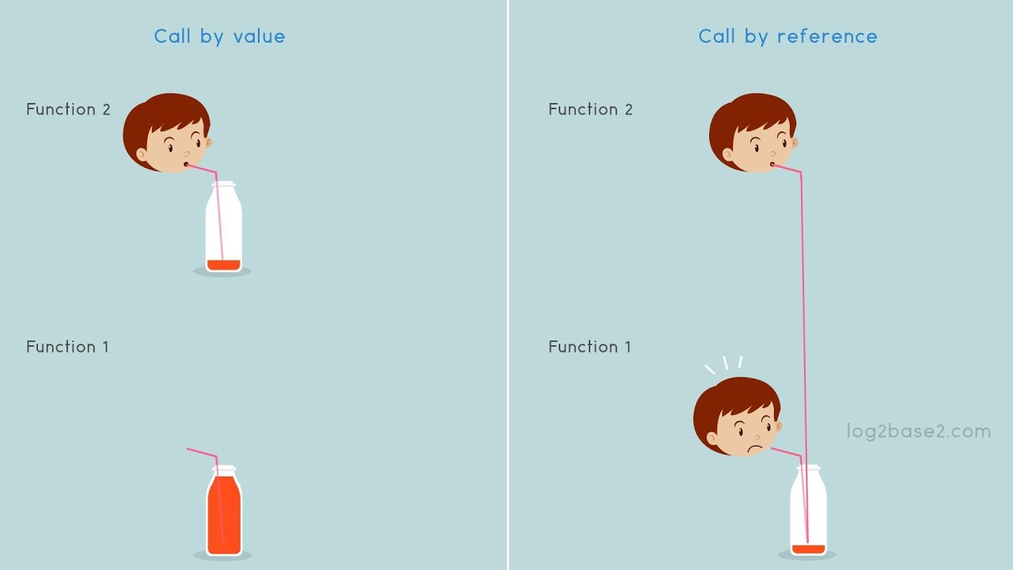
Pass by Reference and pass by value
When the values of parameters are copied into another variable, it is known as pass by value and when a reference of a variable is passed to a method then it is known as pass by reference.
during method call, values are passed not addresses.

Slide 59
Example:
Example: Call by value:
Class Demo{
Int x, y;
Demo(int a, int b){
x= a, y= b;
}
Class Demo2{
Void add(int a, int b){
a=a+b;
}
Example: Call by refernce:
Class Demo{
Int x, y;
Demo (int a, int b){
x= a, y= b;
}
Class Demo2{
Void add(Demo d){
d.x= d.x+d.y;
}

Slide 60
Practice question:
Create a class called "Car" with the following attributes: "make", "model", and "year". Write a constructor to initialize these attributes and a method called "getInfo" that returns a string with the car's make, model, and year.
Create a class called "BankAccount" with the following attributes: "accountNumber", "balance", and "ownerName". Write a constructor to initialize these attributes and a method called "withdraw" that takes a double parameter and subtracts it from the balance. Also, write a method called "deposit" that takes a double parameter and adds it to the balance.
Create a Calculator class that performs the addition, subtraction, multiplication, division, modulus, power and square root of a number.

Slide 61
What is a constructor
In Java, a constructor is a block of codes similar to the method.
At the time of calling constructor, memory for the object is allocated in the memory.
Every time an object is created using the new() keyword, at least one constructor is called.
It is called constructor because it constructs the values at the time of object creation. It is not necessary to write a constructor for a class. It is because java compiler creates a default constructor if your class doesn't have any.

Slide 62
Rules
There are two rules defined for the constructor.
Constructor name must be the same as its class name
A Constructor must have no explicit return type
A Java constructor cannot be abstract, static, final, and synchronized

Slide 63
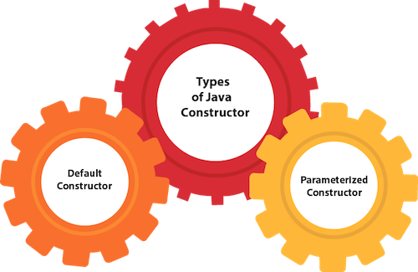
Types of Constructor
Non-Parameterized Constructor

Slide 64
EXAMPLE FOR NON- PARAMETERIZED CONSTRUCTOR
class Bike1{
//creating a default constructor
Bike1()
{
System.out.println("Bike is created");
}
//main method
public static void main(String args[]){
//calling a default constructor
Bike1 b=new Bike1();
}
}

Slide 65
Parameterized Constructor
A constructor which has a specific number of parameters is called a parameterized constructor.
The parameterized constructor is used to provide different values to distinct objects.

Slide 66
Parameterized Constructor
class Student{
int id;
String name;
Student(int i, String n)
{
id=i;
name=n;
}}
public static void main(String args[]){
Student st1=new Student(12,"Pritpal");
Student st2=new Student(13,"Pritpal2");
System.out.println(st1.id);
System.out.println(st1.name);
System.out.println(st2.id);
System.out.println(st2.name);
}

Slide 67
Difference between Constructors and methods
Java Constructor | Java Method
A constructor is used to initialize the state of an object. | A method is used to expose the behavior of an object.
A constructor must not have a return type. | A method must have a return type.
The constructor is invoked implicitly. | The method is invoked explicitly.
The Java compiler provides a default constructor if you don't have any constructor in a class. | The method is not provided by the compiler in any case.
The constructor name must be same as the class name. | The method name may or may not be same as the class name.

Slide 68
Access Specifiers
How a member can be accessed is determined by the access specifier that modifies its declaration. Java supplies a rich set of access specifiers. Some aspects of access control are related mostly to inheritance or packages.
Java’s access specifiers are
Public: When a member of a class is modified by the public specifier, then that member can be accessed by any other code.
Private: When a member of a class is specified as private, then that member can only be accessed by other members of its class.
Protected: A protected member can be accessed by any class that is in the same package as the protected member, or by a subclass of the class in which the protected member is defined, even if the subclass is in a different package.
note: protected applies only when inheritance is involved. by default the member of a class is public within its own package, but cannot be accessed outside of its package.

Slide 69
Example for private access specifiers
Example: class Test { int a; public int b; private int c; void setc(int i) { c = i; } int getc() { return c; } }
class AccessTest { public static void main(String args[]) { Test ob = new Test(); ob.a = 10; ob.b = 20; ob.c = 100; ob.setc(100); System.out.println("a, b, and c: " + ob.a + " " + ob.b + " " + ob.getc()); }}

Slide 70
Non Access modifiers
Along with access modifiers, Java provides non-access modifiers as well. These modifier are used to set special properties to the variable or method.
Non-access modifiers do not change the accessibility of variable or method, but they provide special properties to them. Java provides following non-access modifiers.
Final
Static
Transient
Synchronized
Volatile

Slide 71
This keyword
In Java, this is a keyword which is used to refer current object of a class. we can be used to refer any member of the class. It means we can access any instance variable and method by using this keyword.
We can use this keyword for the following purpose.
this keyword is used to refer to current object.
this is always a reference to the object on which method was invoked.
this can be used to invoke current class constructor.
this can be passed as an argument to another method.
Example:
class Demo
{
Double width, height, depth;
Demo (double w, double h, double d)
{
this.width = w;
this.height = h;
this.depth = d;
}
public static void main(String[] args) {
Demo d = new Demo(10,20,30);
System.out.println("width = "+d.width);
System.out.println("height = "+d.height);
System.out.println("depth = "+d.depth);
}
}

Slide 72
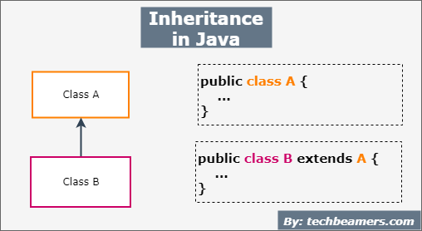
Inheritance in Java
Inheritance is one of the cornerstones of object-oriented programming because it allows the creation of hierarchical classifications. Using inheritance, you can create a general class that defines traits common to a set of related items.
In the terminology of Java, a class that is inherited is called a superclass. The class that does the inheriting is called a subclass.
To inherit a class, you simply incorporate the definition of one class into another by using the extends keyword.
Syntax: class subclass-name extends superclass-name { // body of class }
Note: You can only specify one superclass for any subclass that you create. Java does not support the inheritance of multiple superclasses into a single subclass.

Slide 73
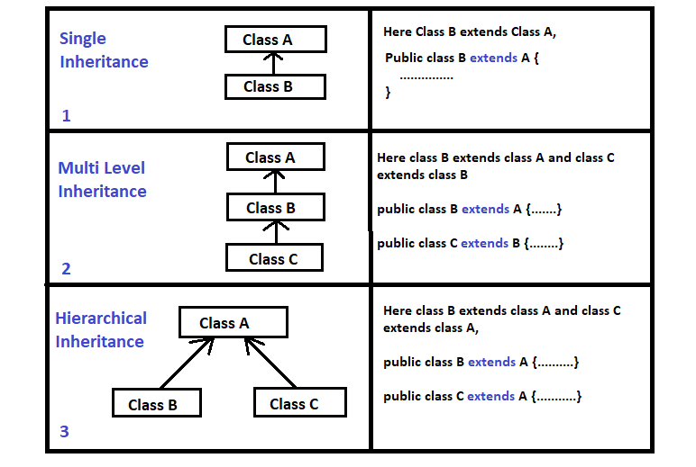
Types of inheritance:

Slide 74
Member Access and Inheritance
Although a subclass includes all of the members of its superclass, it cannot access those members of the superclass that have been declared as private. For example, consider the following simple class hierarchy:
class A { int i; // public by default private int j; // private to A void setij(int x, int y) { i = x; j = y; } } class B extends A { int total; void sum() { total = i + j; // ERROR, j is not accessible here } }

Slide 75
Using super
Whenever a subclass needs to refer to its immediate superclass, it can do so by use of the keyword super.
super has two general forms. The first calls the superclass’ constructor. The second is used to access a member of the superclass that has been hidden by a member of a subclass.
Using super to Call Superclass Constructors:
class B extends A { double d; B(double w, double h, double d, double m) { super(w, h, d); // call superclass constructor d = m; } }

Slide 76
A Second Use for super
The second form of super acts somewhat like this, except that it always refers to the superclass of the subclass in which it is used.
This second form of super is most applicable to situations in which member names of a subclass hide members by the same name in the superclass. Consider this simple class hierarchy:
class A { int i; }
// Create a subclass by extending class A. class B extends A { int i; // this i hides the i in A B(int a, int b) { super.i = a; // i in A i = b; // i in B }}

Slide 77
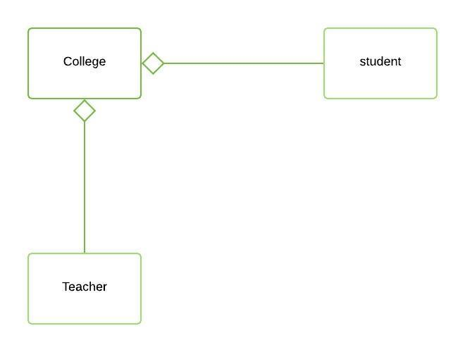
Aggregation
Aggregation is a term which is used to refer one way relationship between two objects.
In Java, aggregation represents HAS-A relationship, which means when a class contains reference of another class known to have aggregation.
The HAS-A relationship is based on usage, rather than inheritance. In other words, class A has-a relationship with class B, if class A has a reference to an instance of class B.

Slide 78
When to use Inheritance and when to use aggregation:
When you want to use some property or behavior of any class without the requirement of modifying it or adding more functionality to it, in such case Aggregation is a better option because in case of Aggregation we are just using any external class inside our class as a variable.
Whereas when you want to use and modify some property or behavior of any external class or may be want to add more function on top of it, its best to use Inheritance.

Slide 79
Practice questions:
Create a class called Shape with a method called getArea() that returns the area of the shape. Create subclasses called Rectangle and Triangle that inherit from Shape and override the getArea() method to calculate the area of a rectangle and triangle respectively.
Create a class called BankAccount with properties accountNumber, balance, and interestRate. Create a subclass called CheckingAccount that adds a property called overdraftLimit. Create another subclass called SavingsAccount that adds a property called minBalance.

Slide 80
Practice questions:
Create a class called Animal with a constructor that takes a parameter name and sets it to an instance variable name. Then create a class called Dog that inherits from Animal and also has a constructor that takes a parameter name. In the Dog constructor, use the super keyword to call the Animal constructor with the name parameter.
Create a class called Shape with a method called draw() that prints "Drawing Shape". Then create a class called Rectangle that inherits from Shape and overrides the draw() method to print "Drawing Rectangle". In the Rectangle class, call the draw() method of the Shape class using the super keyword.
Create a class called Person with a private instance variable name. Then create a class called Employee that inherits from Person and has a public method called getEmployeeName() that returns the name variable of the Person class. In the Employee class, use the super keyword to access the name variable of the Person class in the getEmployeeName() method.

Slide 81
Method overloading
Method overloading is a concept that allows to declare multiple methods with same name but different parameters in the same class.
Java supports method overloading and always occur in the same class(unlike method overriding).
There are two different ways of method overloading.
Different datatype of arguments
Different number of arguments

Slide 82
Method overriding:
Method overriding is a process of overriding base class method by derived class method with more specific definition.
Method overriding performs only if two classes have is-a relationship. It mean class must have inheritance. In other words, It is performed between two classes using inheritance relation.
In overriding, method of both class must have same name and equal number of parameters.
Method overriding is also referred to as runtime polymorphism because calling method is decided by JVM during runtime.

Slide 83
Method overriding:
Rules for Method Overriding
1. Method name must be same for both parent and child classes.
2. Access modifier of child method must not restrictive than parent class method.
3. Private, final and static methods cannot be overridden.
4. There must be an IS-A relationship between classes (inheritance).
Note If the return type is void or primitive data type of parent class method than overriding method should be the same. e.g. if the return type is int, float, string then it should be same

Slide 84
Dynamic method dispatch:
Dynamic method dispatch is a mechanism by which a call to an overridden method is resolved at runtime. This is how java implements runtime polymorphism. When an overridden method is called by a reference, java determines which version of that method to execute based on the type of object it refer to. In simple words the type of object which it referred determines which version of overridden method will be called.
Types
Upcasting

Slide 85
Practice questions:
Write a Java program that demonstrates runtime polymorphism. Create a base class named "Vehicle" with a method named "drive", and then create two derived classes named "Car" and "Truck" that override the "drive" method to print "Driving a Car" and "Driving a Truck", respectively. Create an object of each class and call the "drive" method on each object.
Write a Java program that demonstrates compile-time polymorphism. Create a class named "Calculator" with four overloaded methods named "add" that takes two, three, four, or five integers as arguments and returns their sum. Create an object of the "Calculator" class and call each of the "add" methods with different numbers of arguments.

Slide 86
Practice questions
https://www.hackerrank.com/challenges/java-method-overriding/problem?isFullScreen=true
https://www.hackerrank.com/challenges/java-inheritance-2/problem?isFullScreen=true
https://www.hackerrank.com/challenges/java-inheritance-1/problem?isFullScreen=true
https://www.hackerrank.com/challenges/java-method-overriding-2-super-keyword/problem?isFullScreen=true

